Slide 1

Azure Synapse Link for Azure Cosmos DB
L300 deck – best practices

Slide 2

Best Practices
Power BI
Always check your tenant location
Cache can provide a better user experience
For interactive analytics in Power BI direct query mode, you need to use heavy filter/aggregation pushdown and return only the minimal amount of data
Even if you minimize the data volume that is returned, direct query is not the best solution. Our queries take 1-10 sec on a large data sets even with all pushdown optimizations
Refresh your Power BI dashboard every ~30 min so it would not make any difference if the background query runs for 1 or 15 minutes. The only important thing is that the query finishes before the next refresh.
Avoid returning millions of records to a dashboard: this is computing intensive and not optimal architecture

Slide 3
Best Practices | Power BI
There is also a Power BI mixed mode where you have some tables in full refresh and other in direct query mode
Scheduled refreshes can avoid parallel queries execution, what drains SQL Serverless pool resources
If you cannot use Azure Analysis Services, another solution is to use CETAS to export some parts of your data that will not be changed as Parquet files. Then you can query read-only partitions in Parquet, and frequently changed data via Synapse Link for Cosmos DB.
In some scenarios you can create multiple workspace pointing to the same Cosmos DB analytical store, to increase the bandwidth/max compute

Slide 4
Best Practices | Co-location
Co-locate data and analytical workloads in the same Azure Region. You can use the connection string to change from the primary to any other secondary region.
Perfect storm / real case:
Data = West US 2
Synapse Workspace = East US
Power BI tenant = North Europe
Users = India

Slide 5
Best Practices
Spark can be used to pre-aggregate common analytical queries, saving data in another Azure data service like ADLS. This “write once/read many” approach can avoid heavy queries been executed over and over
If you are joining data from Cosmos DB analytical store and Data Lake store:
Make sure that they are in the same region.
Use filters to avoid big data volumes been moved across your azure infrastructure
Currently only Latin1_General_100_BIN2_UTF8 collation can push filters down, what avoids all data been transfered from storage to Synapse
If you are casting/converting data to char or varchar in query time, use the most optimal size

Slide 6
Best Practices
Automatic inference converts datatypes to a format that may not be optimal. It’s recommended for ad-hoc queries but not for production process. Use the WITH clause to optimize datatypes
Synapse SQL Serverless pools have resource limits. Queries executed simultaneously will consume those resources at the same time and may reach a limit. It’s common to see PBI dashboards reaching these limits when multiple refreshes are happing in parallel. Tests and scheduled refreshes can help you to avoid this problem. Also, multiple Synapse workspaces can address bigger concurrency requirements.
The difference between serverless and dedicated is only in payment model and max compute size. Serverless has auto-scalable compute that matches mid-size dedicated pool. The only difference is in the highly concurrent workload where you would need to use large dedicated pools (bigger than DW2000c) to handle workload.

Slide 7
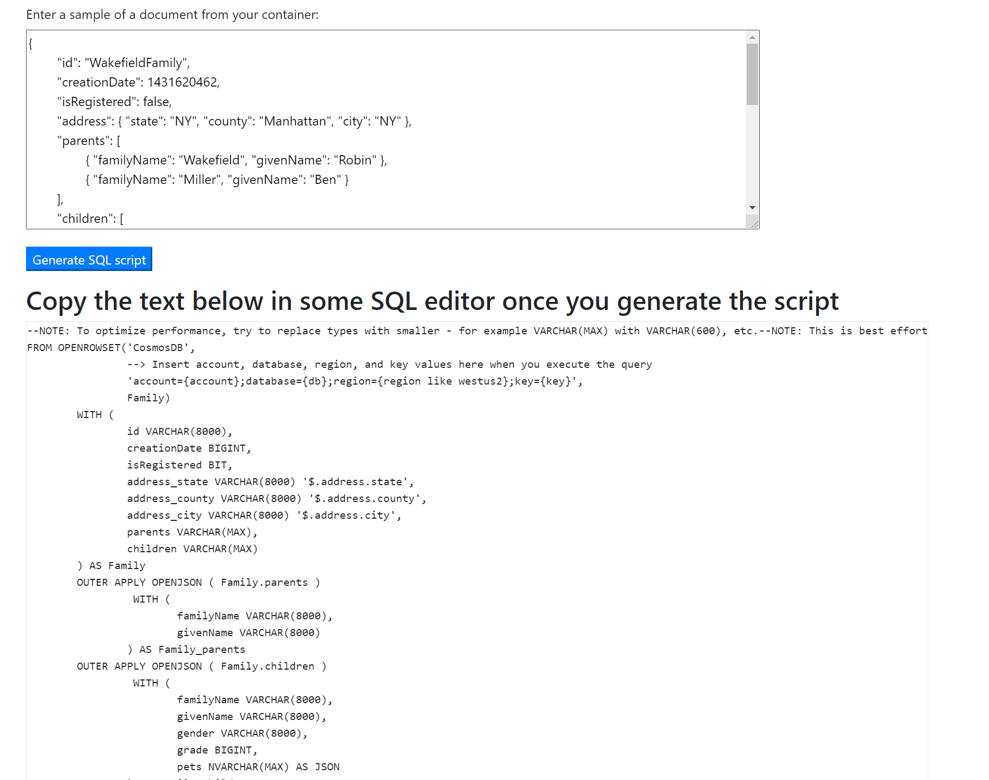
Best Practices | Generators
Use the recommendations generator to check optimization opportunities, including datatypes
Use the Statement Generator to:
Create a template that exposes nested data as columns
Allows you to optimize datatypes as suggested from the recommendation's generator
Use the query below to determinate the actual size of the columns that need optimization
select DISTINCT 'select max(len('+c.name+')) from ' + o.name
from sys.columns c , sys.objects o, sys.schemas s,qpi.recommendations r
WHERE
c.object_id=o.object_id AND
o.type = 'V’ AND
r.name = 'OPTIMIZE COLUMN TYPE’ AND
o.schema_id = s.schema_id AND
s.name = r.schema_name AND
o.name = r.object AND
c.name = r.column_name

Slide 8
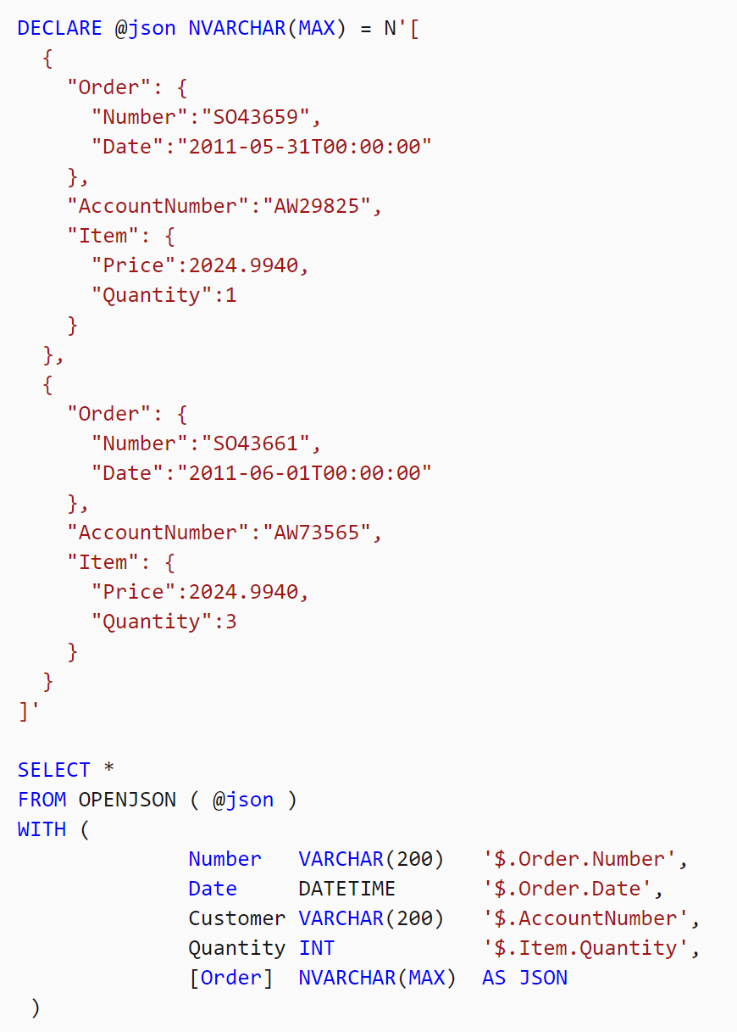
Best Practices | OPENJSON
Use the OPENJSON function to expose nested JSON data as columns
But if you also use the AS JSON option, the column type must be NVARCHAR(MAX), what is not ideal for performance

Slide 9
Best Practices | Understand the T-SQL JOINS
CROSS APPLY
When CROSS is specified, no rows are produced when the right_table_source is evaluated against a specified row of the left_table_source and returns an empty result set
When you have to expand JSON arrays stored in individual fields and join them with their parent rows, you typically use the Transact-SQL CROSS APPLY operator
OUTER APPLY
When OUTER is specified, one row is produced for each row of the left_table_source even when the right_table_source evaluates against that row and returns an empty result set

Slide 10
Best Practices
SELECT TOP 1 * …
TOP(X) queries are not simple!
They need to read complete collection before returning the results
Filters will help to improve performance
The first execution in any serverless service has a cold start delay
Expect that the first cold-run query is ~20% slower because we are reading statistic
Keep the service active to avoid it

Slide 11
Best Practices
MongoDB - _id
ObjectId(<hexadecimal>)
Needs datatype conversion for filtering better visualization
Scala
import org.apache.spark.sql.types._
val simpleSchema = StructType(Array(
StructField("_id", StructType(Array(StructField("objectId",BinaryType,true)) ),true),
StructField("id", StringType, true)
))
var df = spark.read.format("cosmos.olap").option("spark.synapse.linkedService", "CosmosDbMongoDbApi2").option("spark.cosmos.container", "HTAP").schema(simpleSchema).load()
df.select("id", "_id.objectId").show()
SQL
SELECT TOP 100 id=CAST(_id as VARBINARY(1000))
FROM OPENROWSET('CosmosDB',
'Account=your-account;Database=your-database;Key=your-key',
HTAP) WITH (_id VARCHAR(1000)) as HTAP

Slide 12
Best Practices
JSON does not have a built-in type for date/time values
Therefore, Cosmos DB also does not have a format for date/time
ISO 8601 and other formats will be read from Synapse runtimes as JSON in a string datatype column
With that you can use regular JSON functions to parse it and extract the information, and covert it to date/time

Slide 13
Best Practices
Cosmos DB transactional store partition key isn’t used in analytical store. With Synapse Link, now you can model your transactional data to optimize data ingestion and point reads
Don’t set your transactional ttl to less than 2 minutes, the data will be archived before the analytical store sync job execution, meaning that the data won’t be represented in analytical store. For data volumes smaller than 500 MB / minute, use transactional ttl bigger than 5 minutes.
Currently we don’t support backups for analytical store. Keep on working with regular Cosmos DB back capabilities and transactional ttl to support your recovery requirements

Slide 14
Best Practices
If you have scenarios where the schema of the underlying Azure Cosmos DB container changes over time; and if you want the updated schema to automatically reflect in the queries against the Spark table, you can achieve this by setting the spark.cosmos.autoSchemaMerge option to true in the Spark table options
CI/CD: Currently you can connect your workspace to a source control like GitHub. If you have scripted views, you can change and execute them on your dev endpoint, test them, and commit. These scripts could be pulled into another prod workspace if you create PR to another GitHub account. VSO provides a similar experience.

Slide 15
Best Practices
When you don’t need to load all your container data into a Spark DataFrame, you can leverage df.filter() or df.where() to filter the content you want to load
These predicates are pushed down to storage, avoiding unwanted data to be loaded into the DataFrame
The “query_custom” option is not available when using “cosmos.olap”, meaning that it doesn’t work with Synapse Link

Slide 16
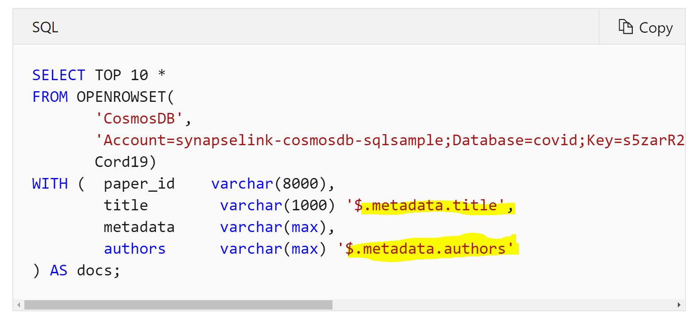
Best Practices
Use the WITH clause to expose nested arrays as columns, with the correct datatype
Query Azure Cosmos DB data using a serverless SQL pool in Azure Synapse Link Preview - Azure Synapse Analytics | Microsoft Docs

Slide 17
Best Practices
Don’t use SELECT * because query will not use column elimination
Don’t use SELECT TOP 100 * without a WHERE clause, it will scan all data
Checking the data schema:
SQL Serverless: Create a view, you can query sys.columns for this view or use sp_describe_first_result_set ‘select top 0 from view’ to check the data types.
Spark: df.printSchema

Slide 18
All Azure Synapse Link for Cosmos DB Key Links
Docs, blog posts, videos, examples, accelerators, best practices…
https://aka.ms/synapse-link-cosmos-db-key-links

